Slide 1
Dunbar GO Team
Business Meeting #2
Where we are – Where we’re going

Slide 2


Where We Are
Our strategic plan is the guide for the work we’re doing in the school. By monitoring the plan and ranking priorities, we can all work towards the common goals. Using the priorities in the strategic plan, the school leadership team developed a Continuous Improvement Plan (CIP) for the current school year.

Slide 3
Timeline for GO Teams
You are HERE
Fall 2021
GO Team Developed 2021-2025 Strategic Plan
1
Summer 2023
School Leadership completed Needs Assessment and defined overarching needs for SY22-23
2
August 2023
School Leadership completed 2023-2024 Continuous Improvement Plan
3
Sept. – Dec. 2023
Utilizing current data, the GO Team will review & possibly update the school strategic priorities and plan
4
Before Winter Break
GO Team will take action (vote) on the rank of the strategic plan priorities for SY24-25 in preparation for budget discussions.
5

Slide 4
Discussion Items
Current Strategic Plan
Continuous Improvement Plan
Needs Assessment
SMART GOALS
Action Plan
Strategic Plan Alignment & Update
MAP Data
Data Protocol

Slide 5
Current
Strategic Plan
2021-2025

Slide 6
Mission-Paul Laurence Dunbar Elementary is a school that nurtures and develops life- long learners who are problem solvers and internationally minded citizens.
Vision-Paul Laurence Dunbar is a school where excellence is expected and all students are developed academically, socially, and emotionally in order to become globally competitive.
Paul L. Dunbar Elementary
Increase the % of grades 3-5 students scoring proficient or above in reading from 17% Spring GMAS 2019 to 20% on Spring GMAS 2022
Increase the % of grades 3-5 students scoring proficient or above in math from 15% on Spring GMAS 2019 to 18% on Spring GMAS 2022
Reduce the number of insubordinate behavior referrals by 10% from 2019 to 2021-2022 SY
Increase parent participation in school hosted events
SMART Goals
APS Strategic Priorities & Initiatives
School Strategic Priorities
School Strategies
Fostering Academic Excellence for All
Data
Curriculum & Instruction
Signature Program
1. Weekly Data Review PLCS
2. International Baccalaureate school-wide implementation
3. Focus on Literacy and Math instructional best practices
1A. Review of NWEA/MAP, HMH, Attendance, and Behavior Data weekly
1B. Quarterly Parent Teacher Data Conferences
1C. Learning Walks for Intervention, Guided Reading, IB, and Math
Building a Culture of Student Support
Whole Child & Intervention
Personalized Learning
Intervention Block with HMH
After School Tutorial
BASC-3 Behavior Screener
Weekly CARE Team Meetings
2A. Care Team weekly meetings and student tracker
2B. Pre and Post Data for students attending after school tutorial
2C. Full-time Wrap-Around Supports (Counselor, Behavior Specialist, MTSS, Social Worker)
Equipping & Empowering Leaders & Staff
Strategic Staff Support
Equitable Resource Allocation
8. Grade Level Leaders
9. Leadership Development Opportunities (Coordinators;Club Sponsors)
10. ESOL,SPED, & Homeless Inclusion
3A. PLC Norms and Protocols
3B. After School Coordinator Leadership Opportunities and Planning Meetings
3C. Allocation of General Budget and other funding sources for ESOL, SPED, & Poverty Students
Creating a System of School Support
Collective Action, Engagement & Empowerment
4A. Monthly School Newsletters
4B. Monday Folder communication of flyers and announcements
4C. Social Media Blasts
4D. Robo Calls and Class Dojo
11. Community Partners Network
12. On-Campus AVLF resources
13. Parent Liaison and Parent Center
14. Community CARE Closet
15. Sheltering Arms Educare Center

Slide 7
Continuous Improvement Plan

Slide 8
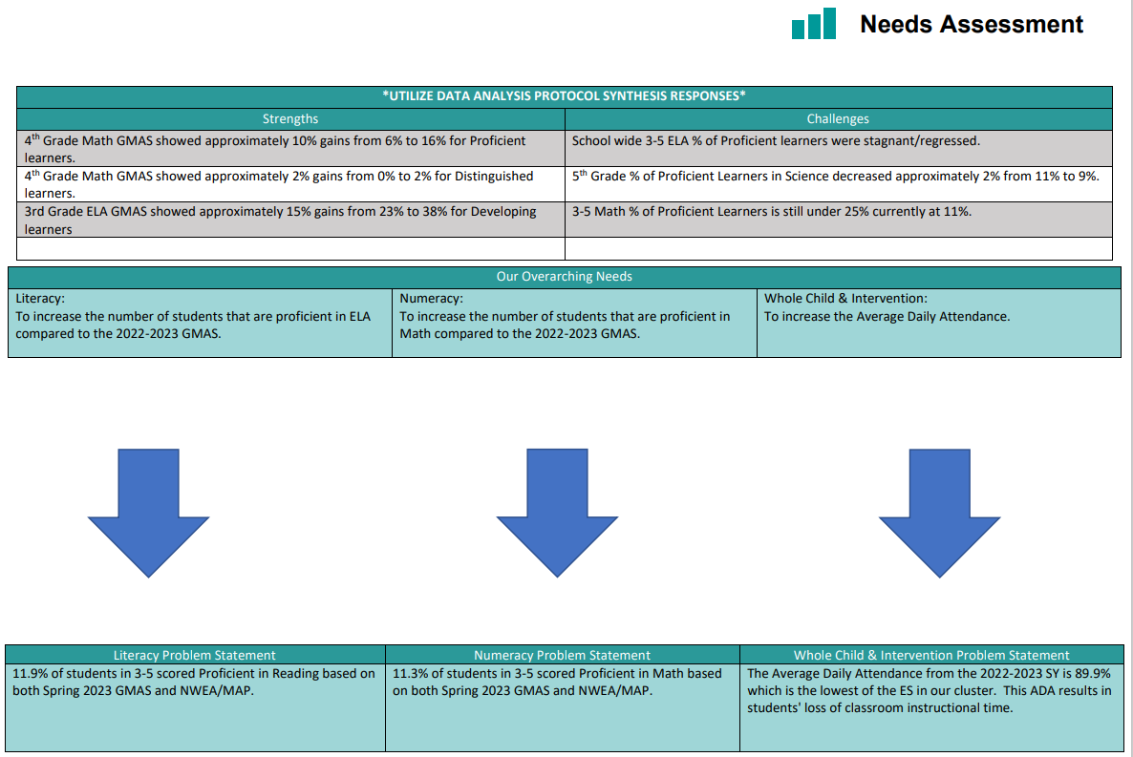
School Name
Needs Assessment
Strengths | Opportunities/Challenges
Before Presenting to
your GO Team:
Insert Your Needs Assessment
(use as many slides as necessary)
Our Overarching Needs
Literacy: | Numeracy: | Whole Child & Student Support
Jamboard Link Here
Literacy Problem Statement | Numeracy Problem Statement | Whole Child & Student Support Problem Statement
Notes:
Notes for School CIP Teams: After completing your Comprehensive Needs Assessment ( data protocol), you will come here and identify some strengths and opportunities/challenges you have observed from the data. The priority areas are Literacy, Numeracy, and Whole Child & Student Support. Identify an overarching need for each area. Formulate a problem statement for each area. Make sure the problem statement meets the criteria. Refer to your CIP resources.

Slide 9
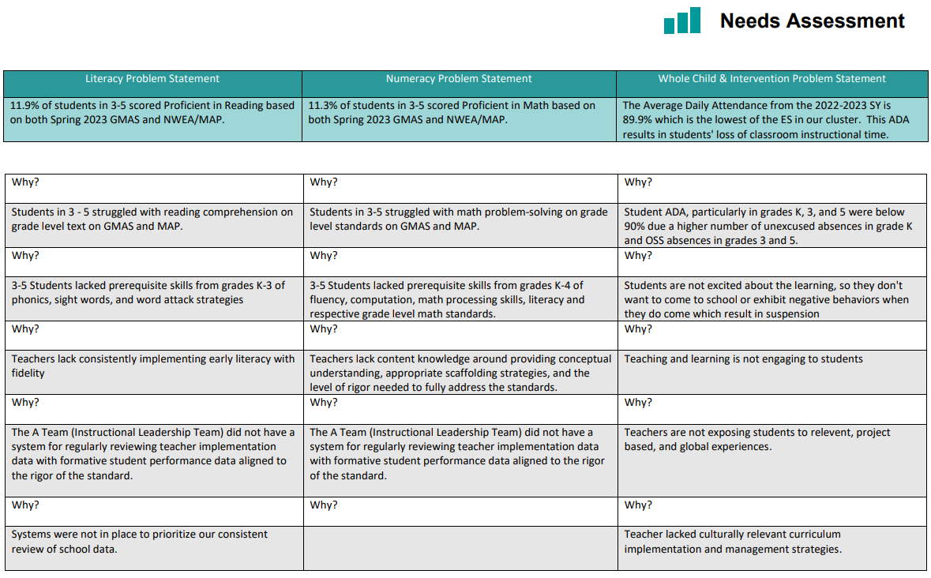
School Name
Needs Assessment
Strengths | Opportunities/Challenges
Before Presenting to
your GO Team:
Insert Your Needs Assessment
(use as many slides as necessary)
Our Overarching Needs
Literacy: | Numeracy: | Whole Child & Student Support
Jamboard Link Here
Literacy Problem Statement | Numeracy Problem Statement | Whole Child & Student Support Problem Statement
Notes:
Notes for School CIP Teams: After completing your Comprehensive Needs Assessment ( data protocol), you will come here and identify some strengths and opportunities/challenges you have observed from the data. The priority areas are Literacy, Numeracy, and Whole Child & Student Support. Identify an overarching need for each area. Formulate a problem statement for each area. Make sure the problem statement meets the criteria. Refer to your CIP resources.

Slide 10
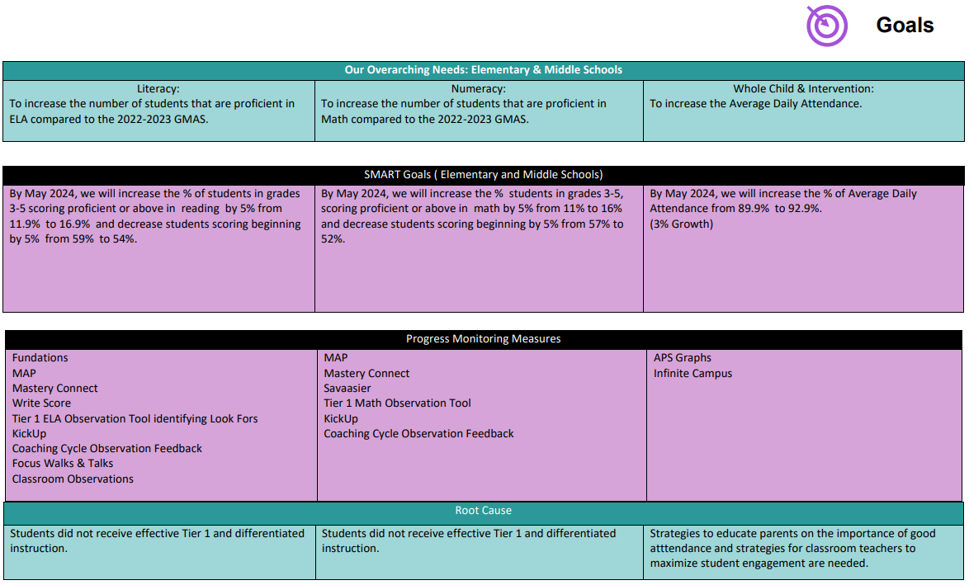

Before Presenting to
your GO Team:
Insert Your Overarching Needs and SMART Goals
(use as many slides as necessary)

Slide 11
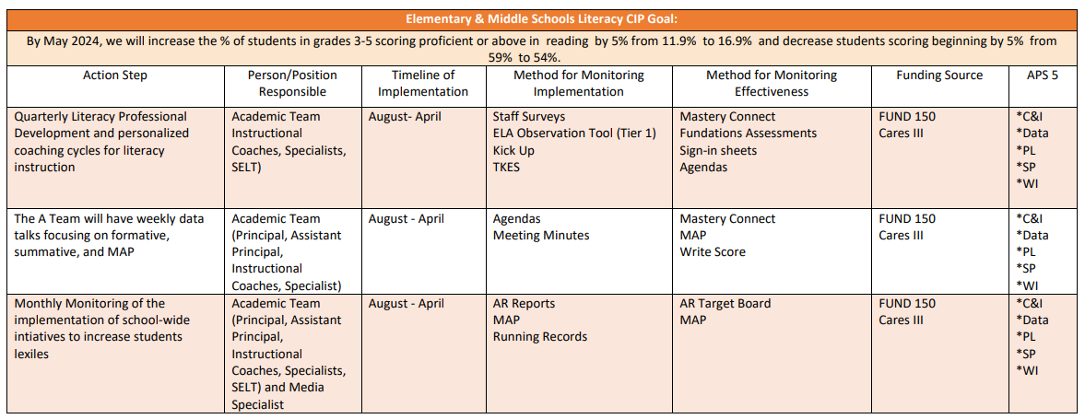
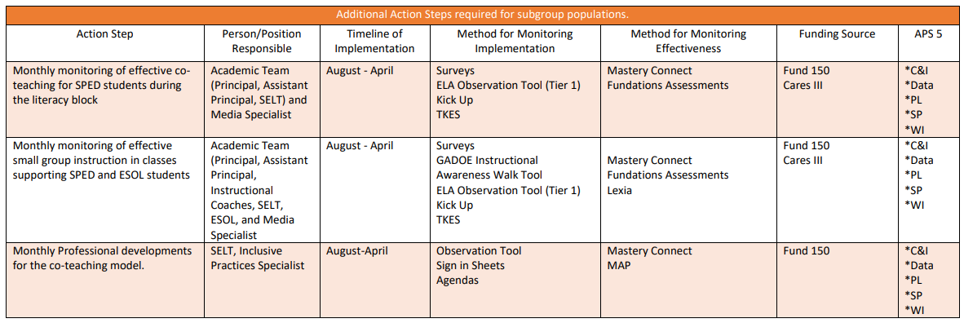

Slide 12
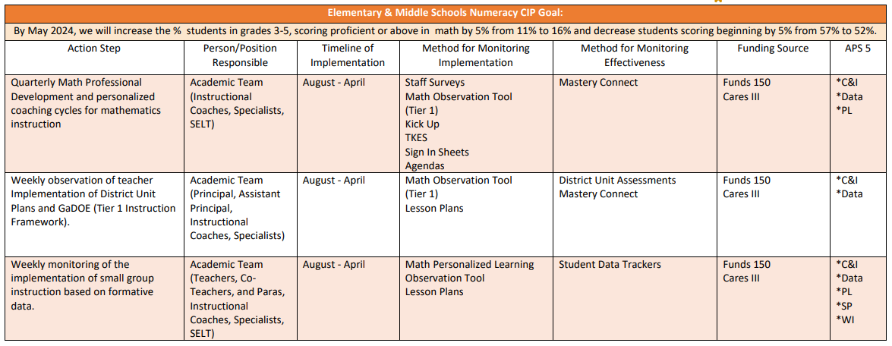
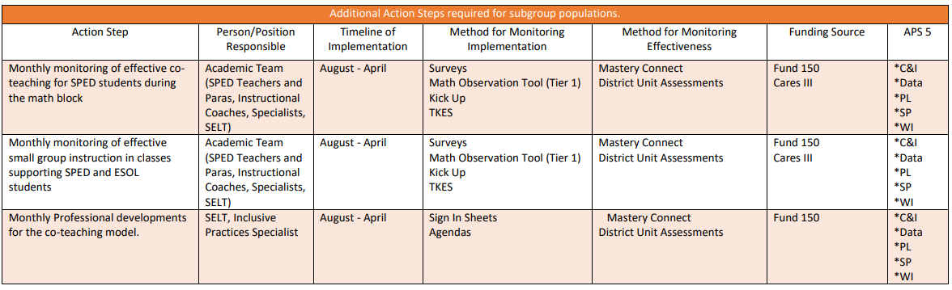

Slide 13
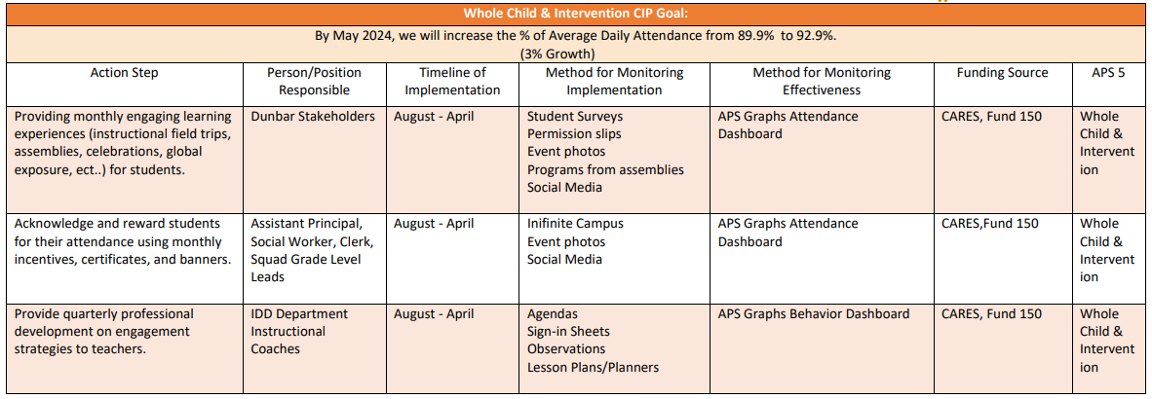
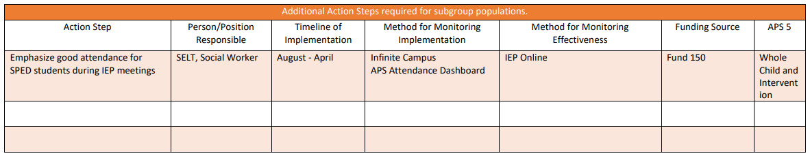

Slide 14
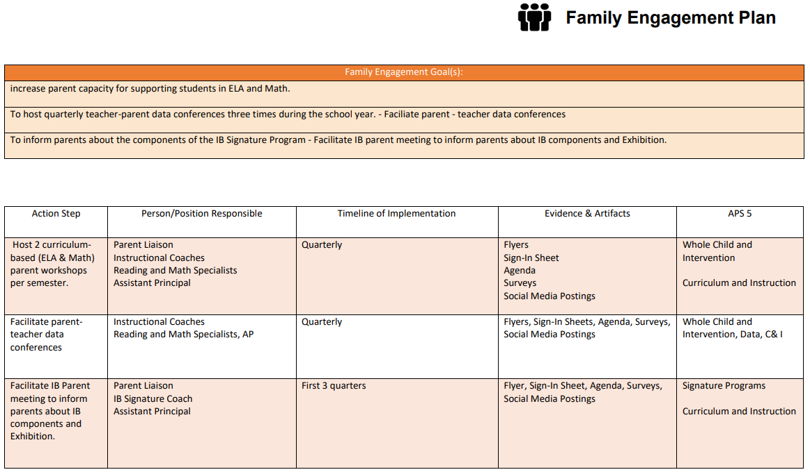

Slide 15
GO Team
Activity
&
Discussion
GO TEAM DISCUSSION: Review the priorities and goals in your strategic plan and the information and goals CIP. Reflect on if updates need to be made to the Strategic Plan.
Are all CIP Goals reflected in
our Strategic Plan Priorities?
If not, which CIP Goal(s) are missing and should be added to the Strategic Plan?

Slide 16

Updates to the
Strategic Plan
Enter all changes/updates to your plan – be sure to include accountability measures, as appropriate.

Slide 17
MAP Data

Slide 18
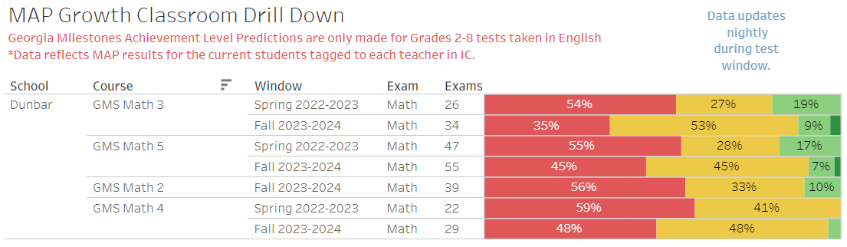
Spring 2023 & Fall 2023 MAP Results

Slide 19

GO Team Discussion:
Data Protocol
What do you notice?
What are your wonderings?
What additional questions do you have?

Slide 20

Strategic planning will help you fully uncover your available options, set priorities for them, and define the methods to achieve them.
Robert J. Mckain

Slide 21


Where we’re going
At our next meeting(s) we will discuss how our data is aligning to our strategic plan and determine if we need to make any adjustments.
Before the end of Fall Semester, we will take Action (vote) on ranking our strategic priorities for the 2024-2025 school year.
Let me or the Chair know of any additional information you need for our future discussion.

Slide 22
Thank you

